Slide 1
Predicting the Stock Market
How Regression can be Applied to Achieve a Parsimonious Model
Nader Liddawi

Slide 2
objectives
DATA COLLECTION
MODEL SELECTION
INFLUENTIAL DIAGNOSTICS
RESIDUAL DIAGNOSTICS
MULTI-COLLINEARITY
MODEL VALIDATION

Slide 3
Predictor variables
EUR/USD forex pair
10-Year Treasury Yield
Microsoft stock
Tesla stock
Bitcoin Spot
Gold Futures (Dec Expiry)

Slide 4
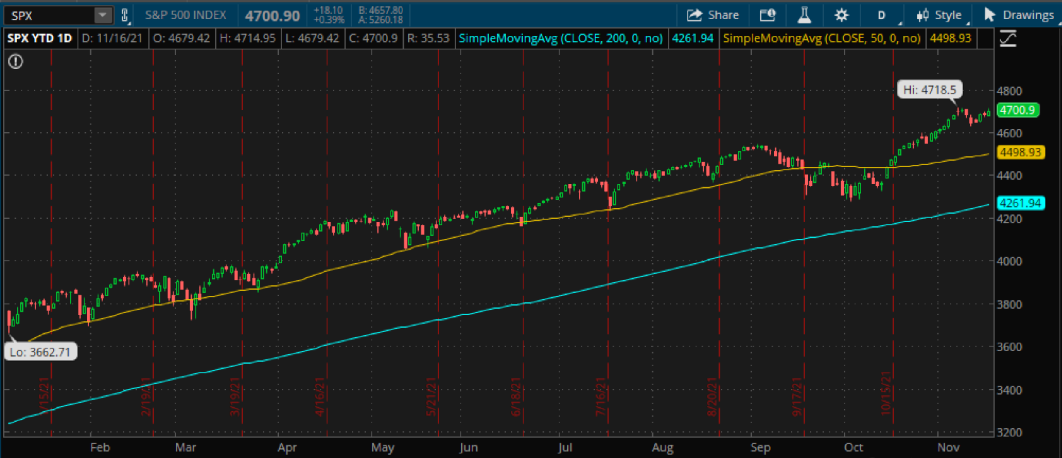

Slide 5
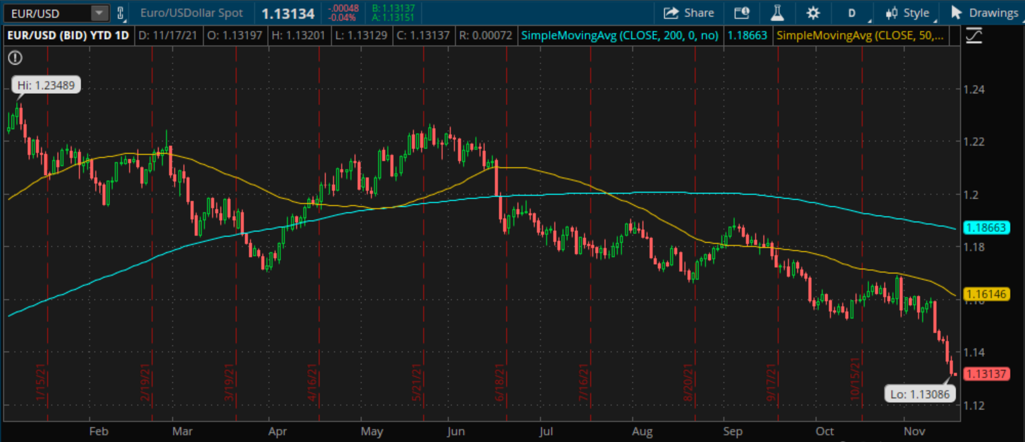
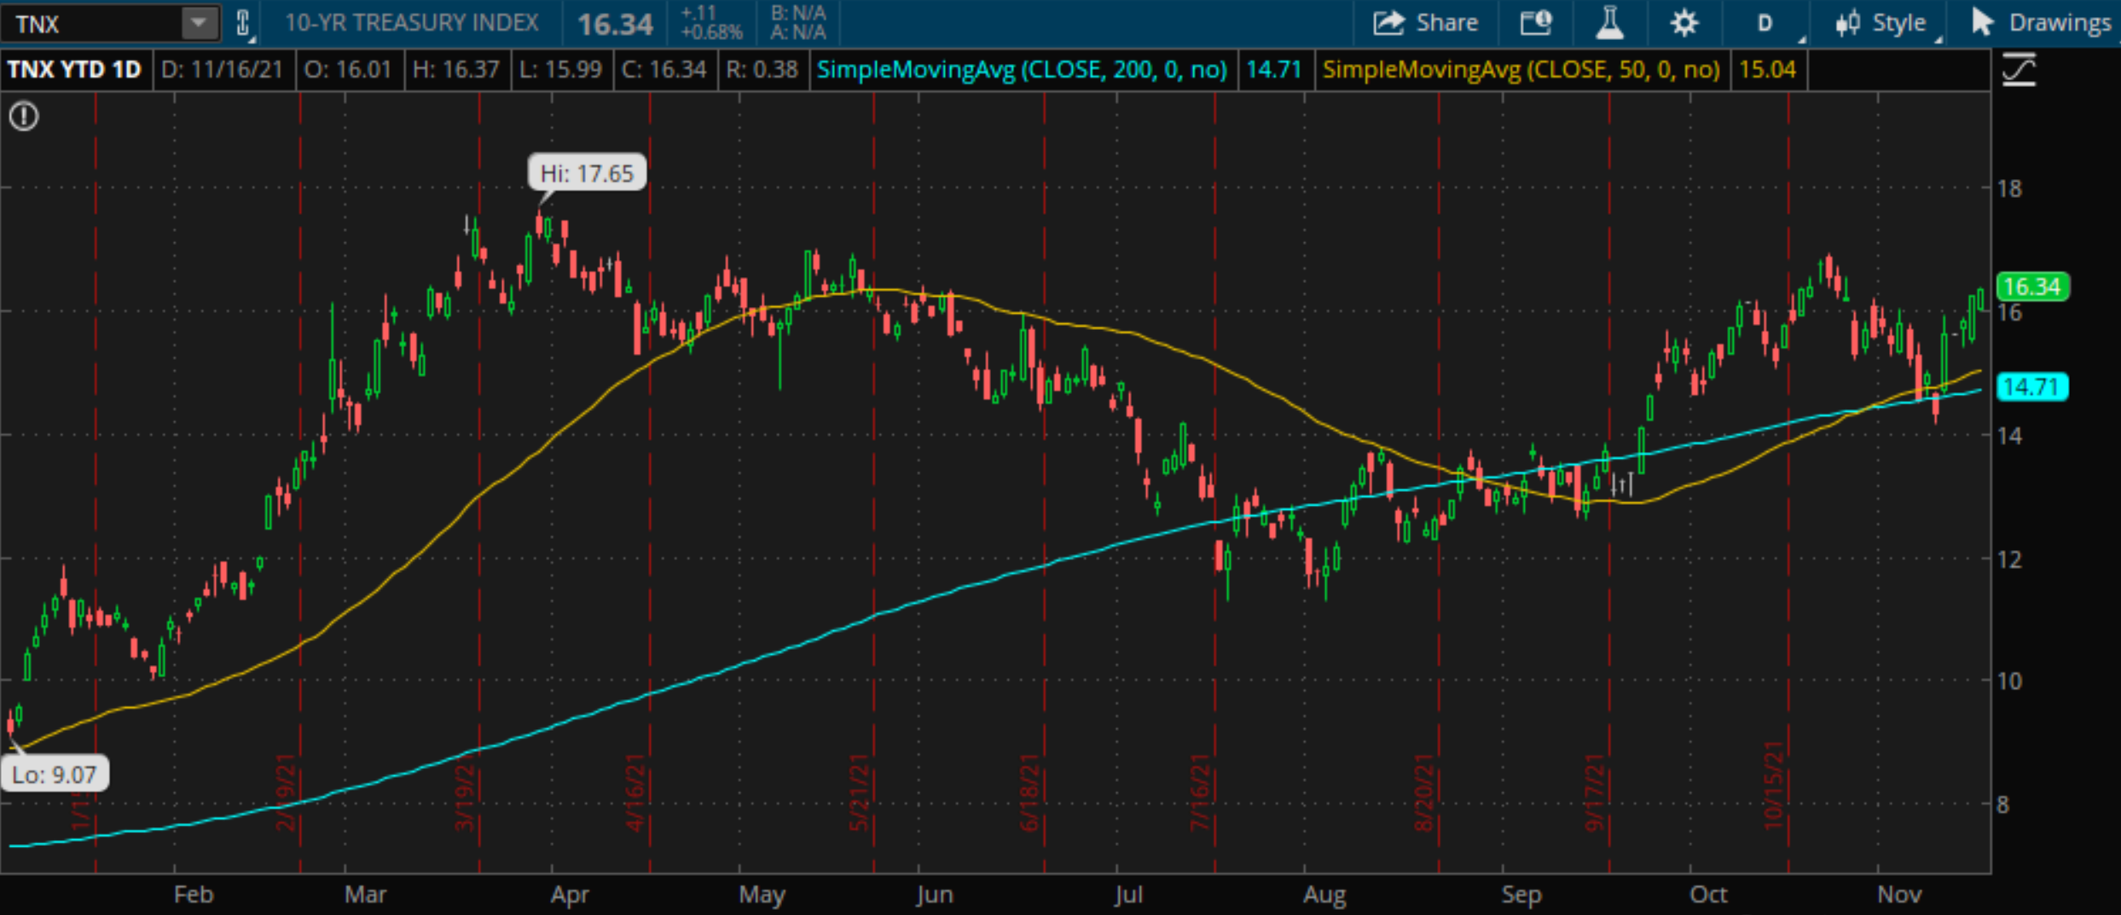

Slide 6
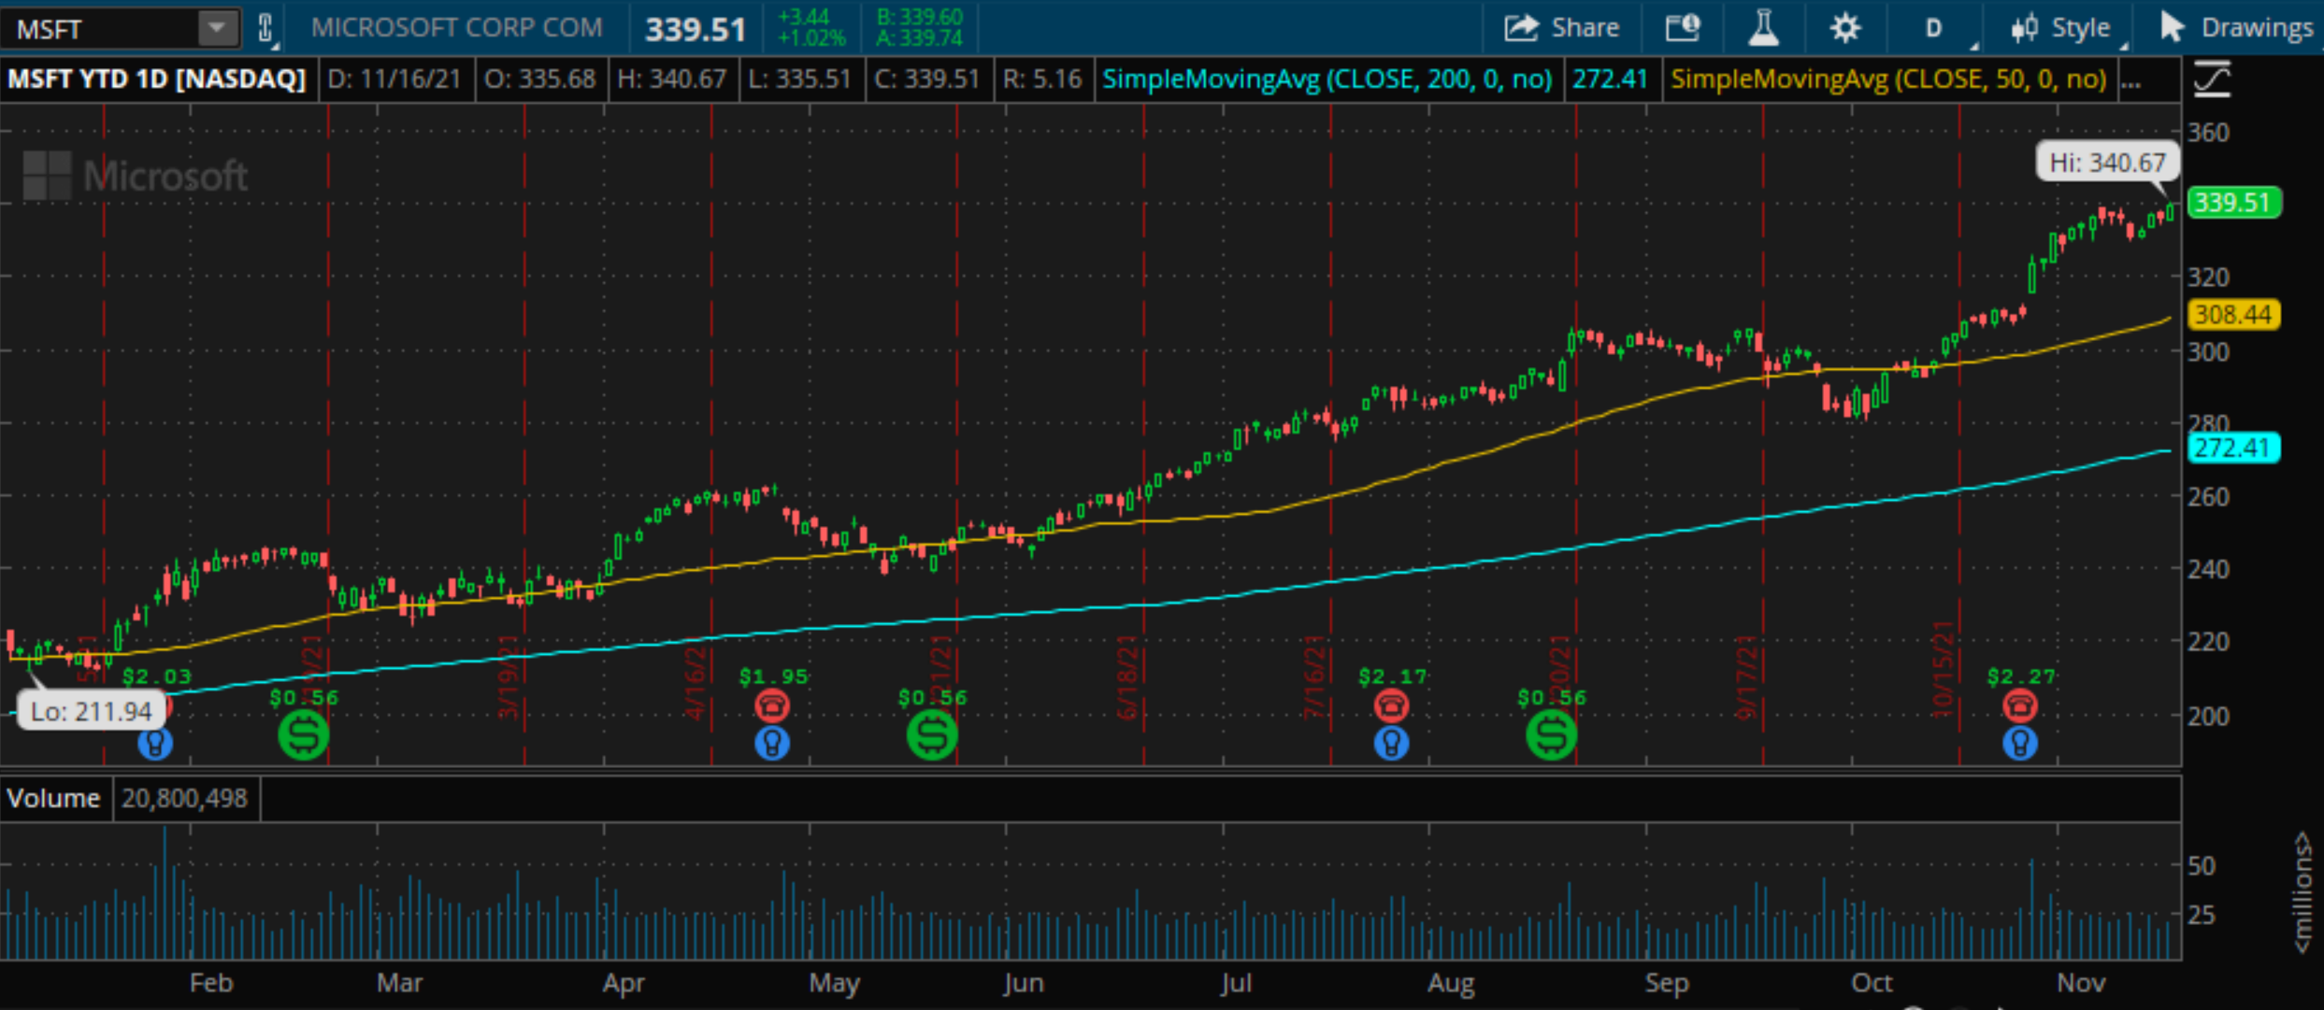
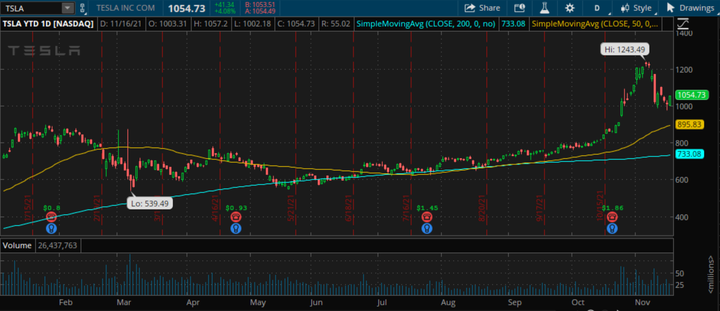

Slide 7
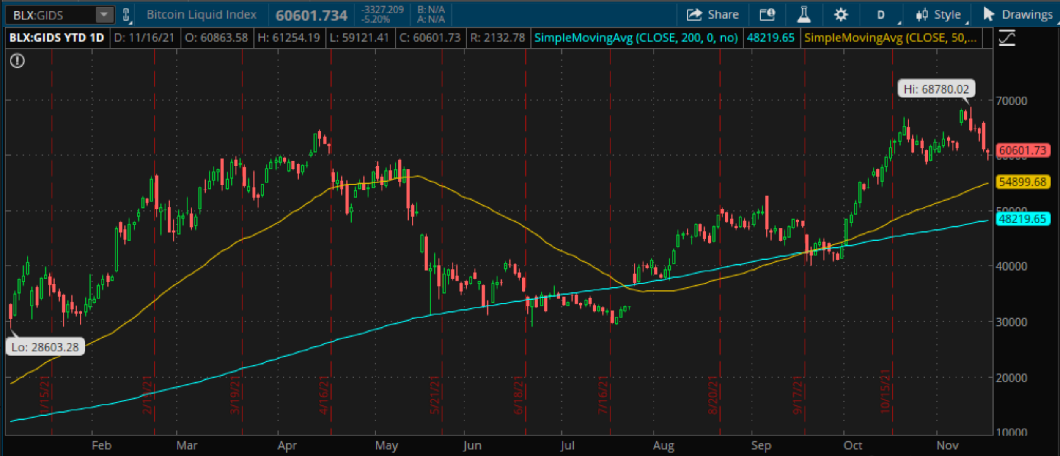
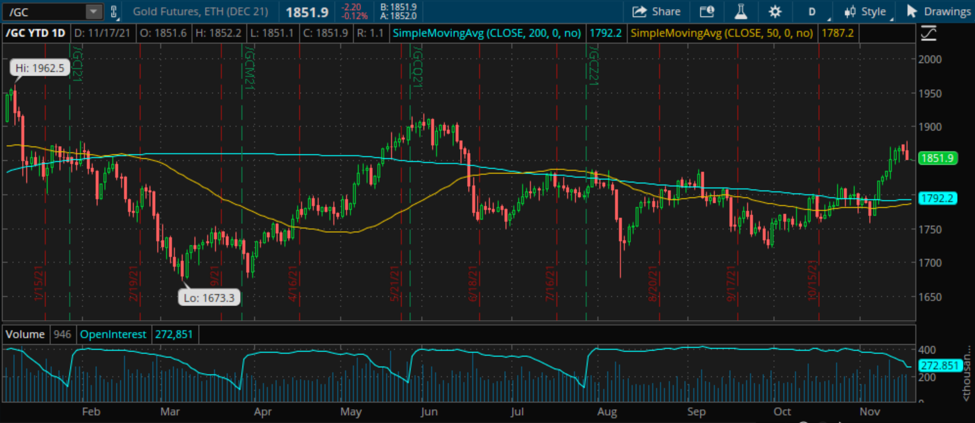

Slide 8
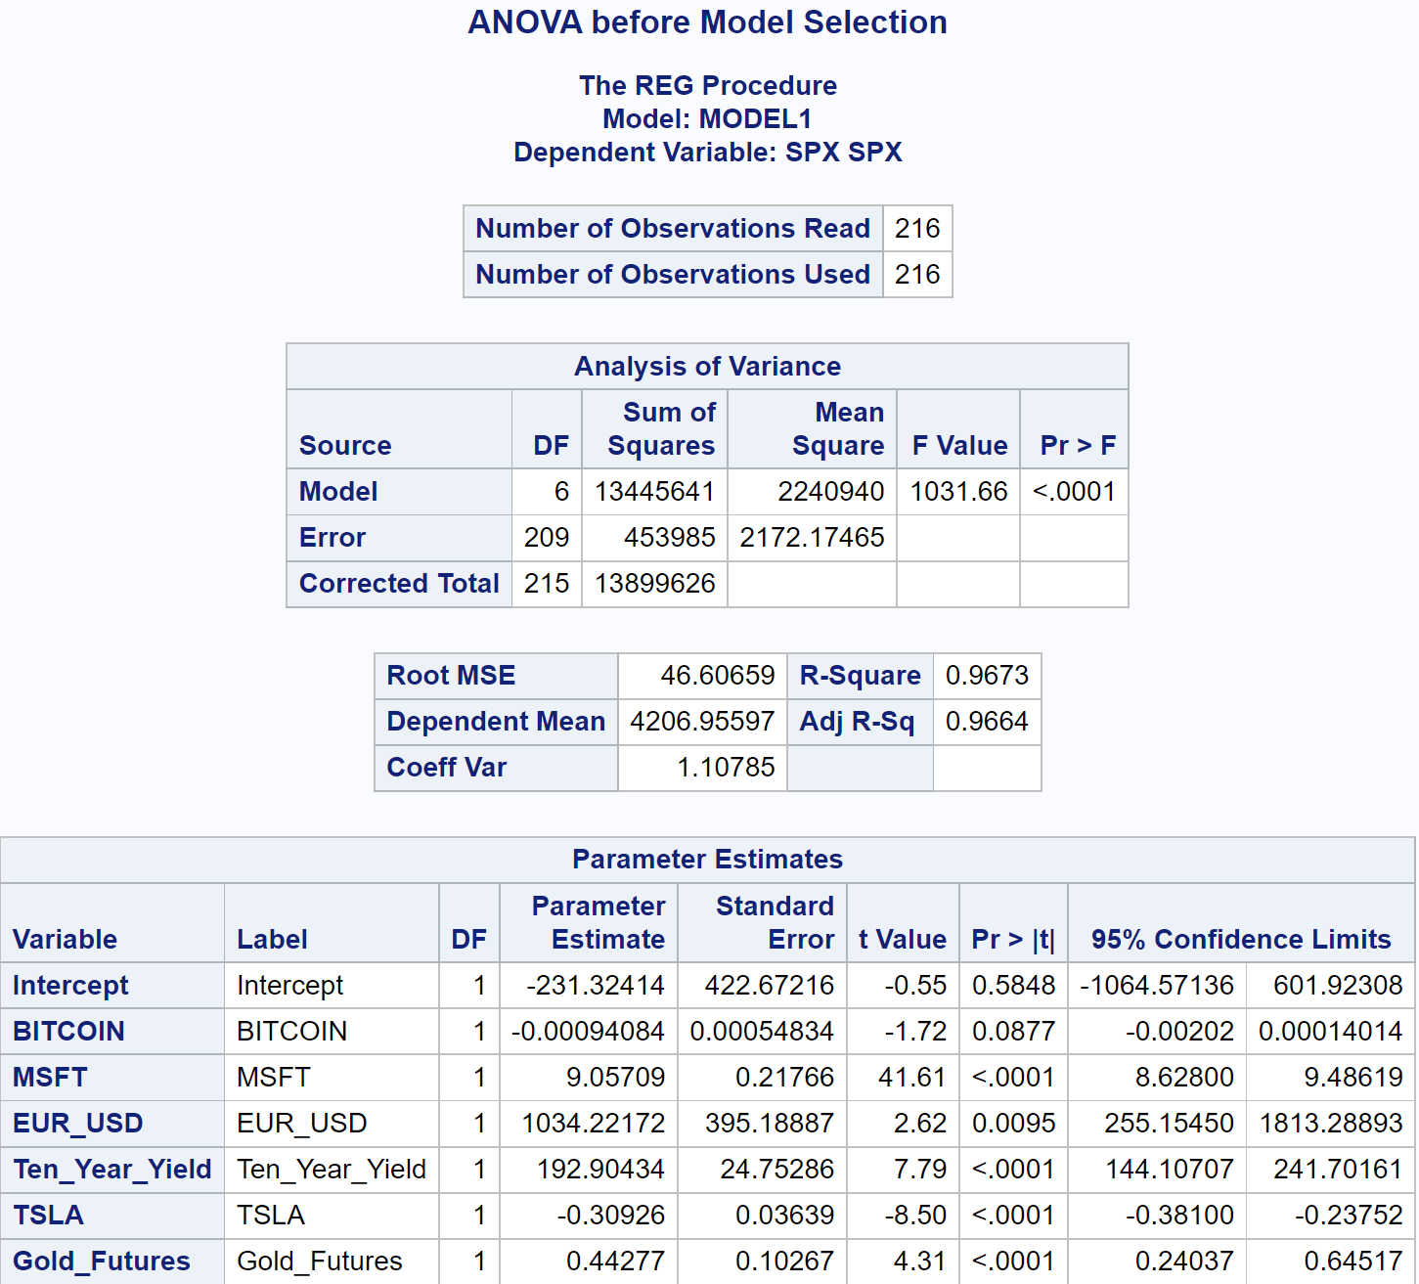
ANOVA using 95% Confidence Level

Slide 9
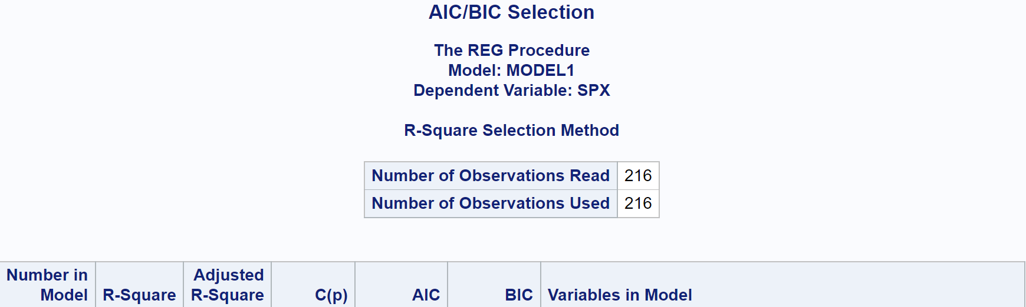
WE FIND 6 predictor VARIABLES USING AIC/BIC

Slide 10
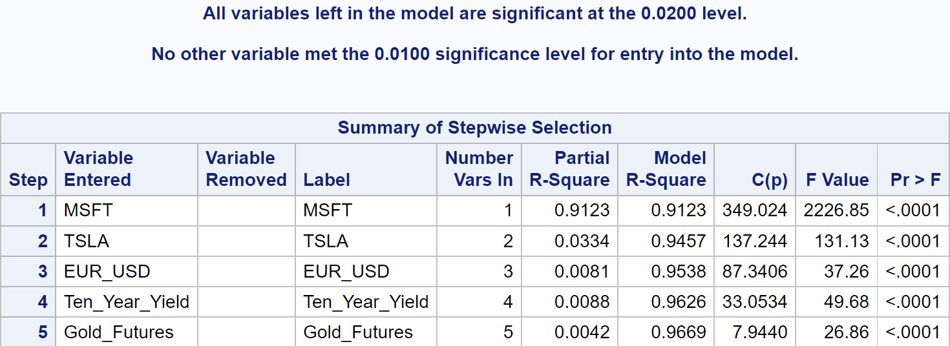
MOST PARSIMONIOUS MODEL USING STEPWISE AUTO-SELECTION

Slide 11
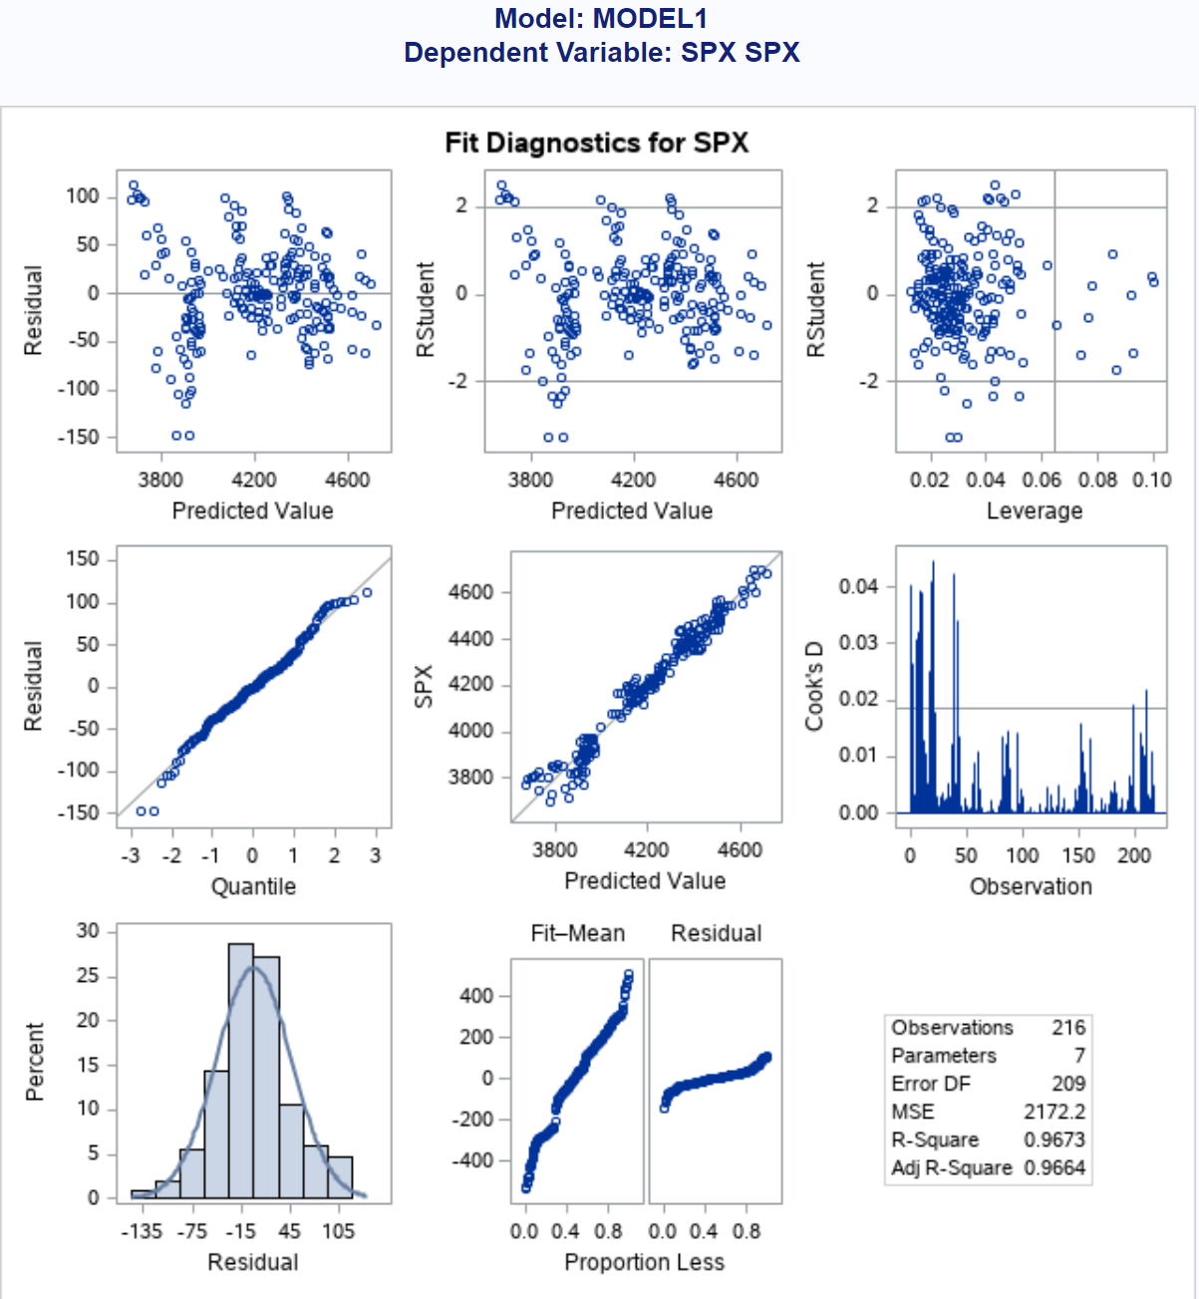

Residual assumptions are Met
However, we will attempt to find potential outliers
We will see if we can make the histogram more normal (or bell-shaped) and the dot plots more randomly scattered

Slide 12
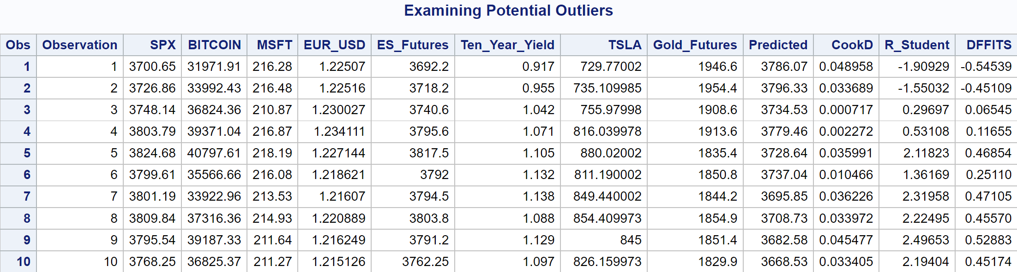
Influential Diagnostics
Cook’s D
R Studentized
DFFITS

Slide 13
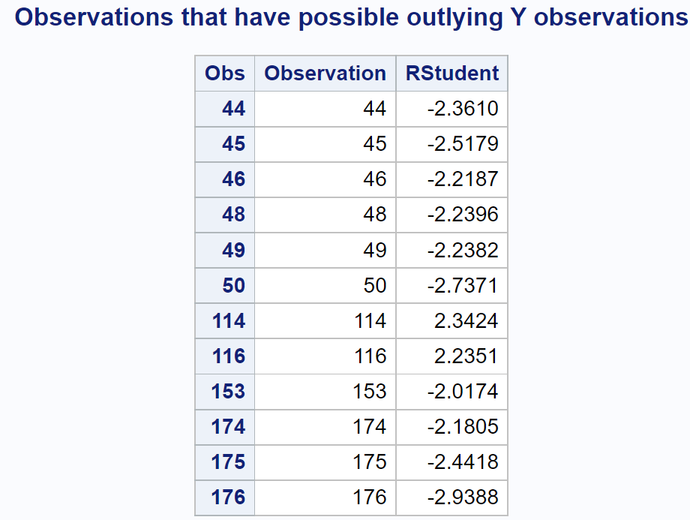
cook’s d TEST

Slide 14
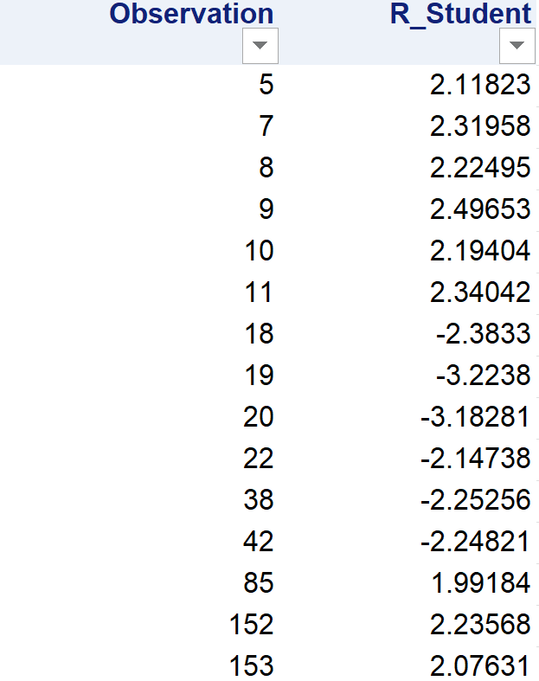
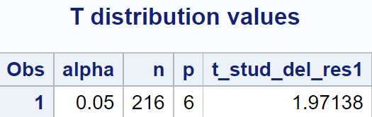
Studentized residual Test

Slide 15
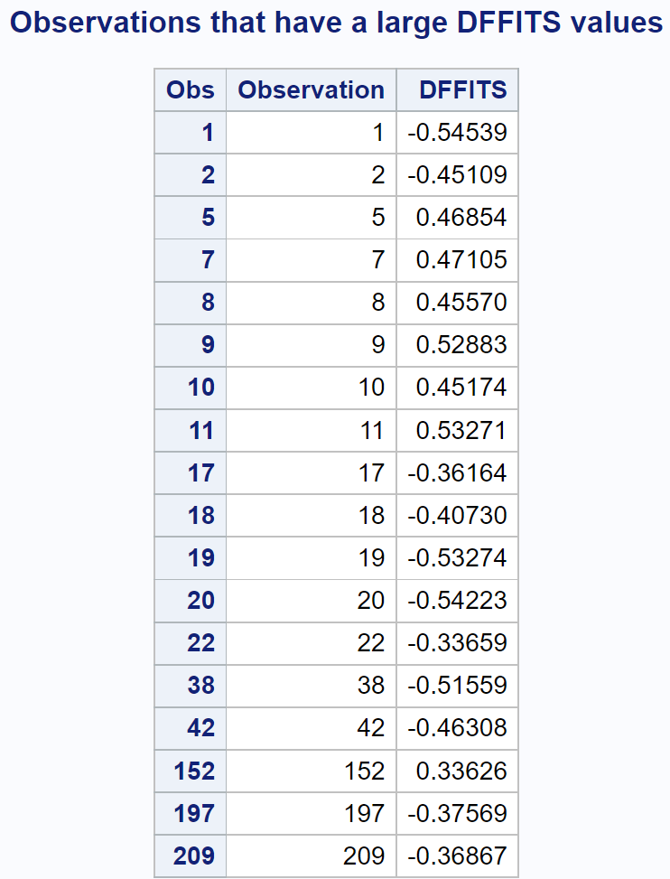
DFFITS Test

Slide 16
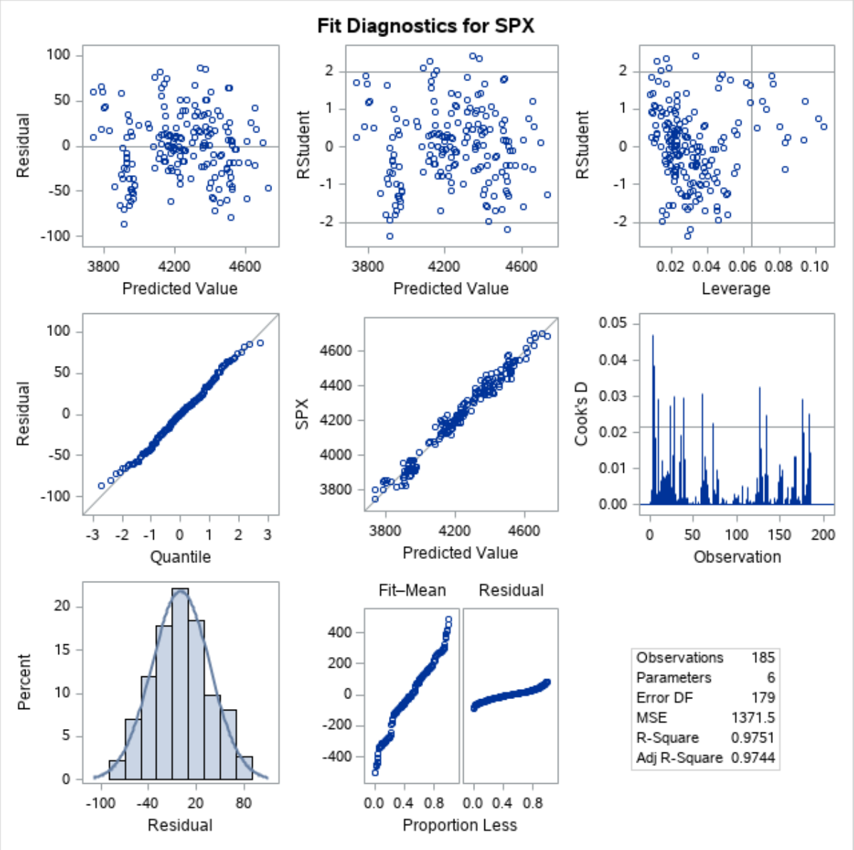
Residual diagnostics correction
Outliers found and deleted
Constancy assumption satisfied, with scatter plots more randomly distributed
Normality assumption satisfied, with histogram more normal or more bell-shaped

Slide 17
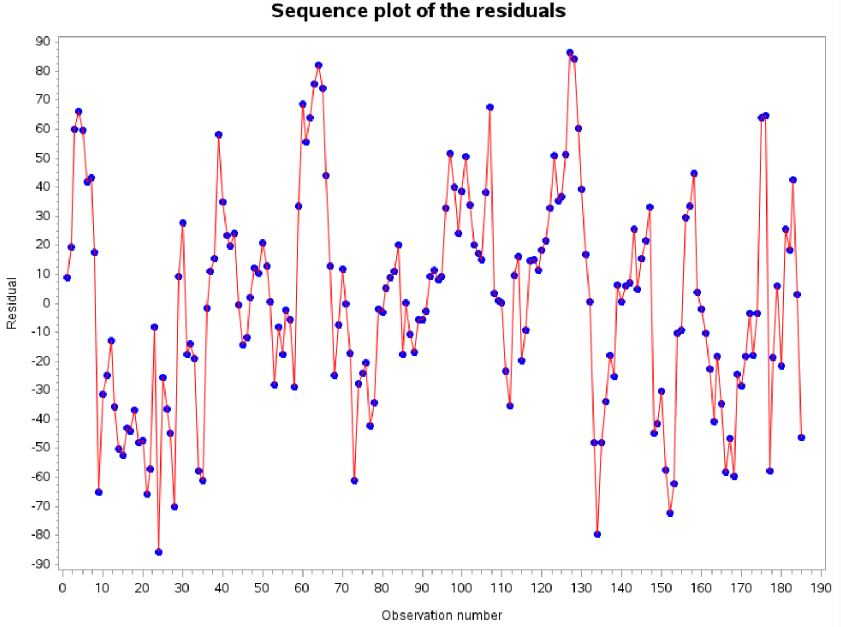
Independence assumption ALSO satisfied
No Pattern

Slide 18
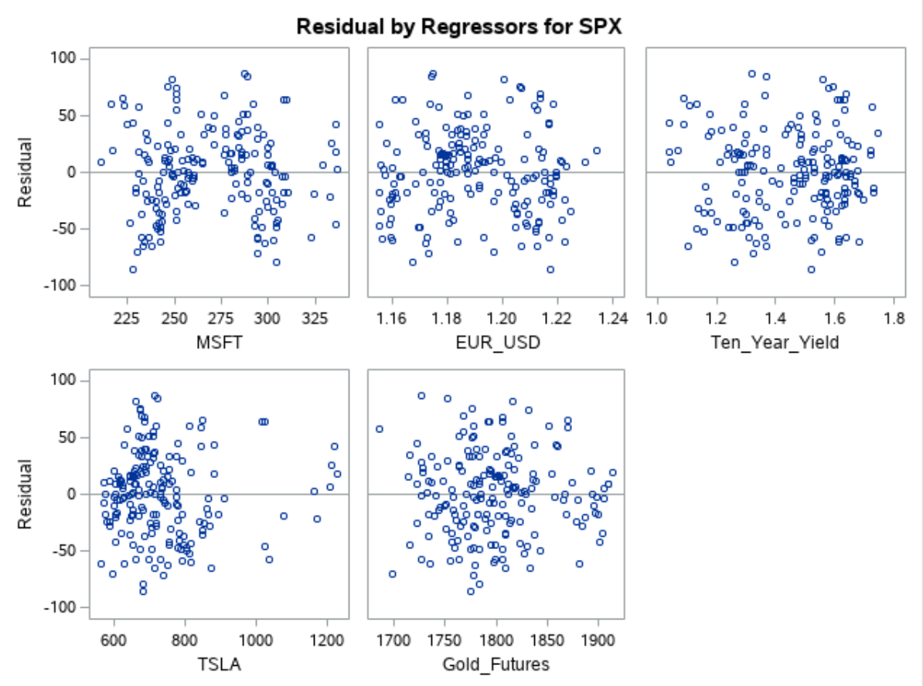

Slide 19
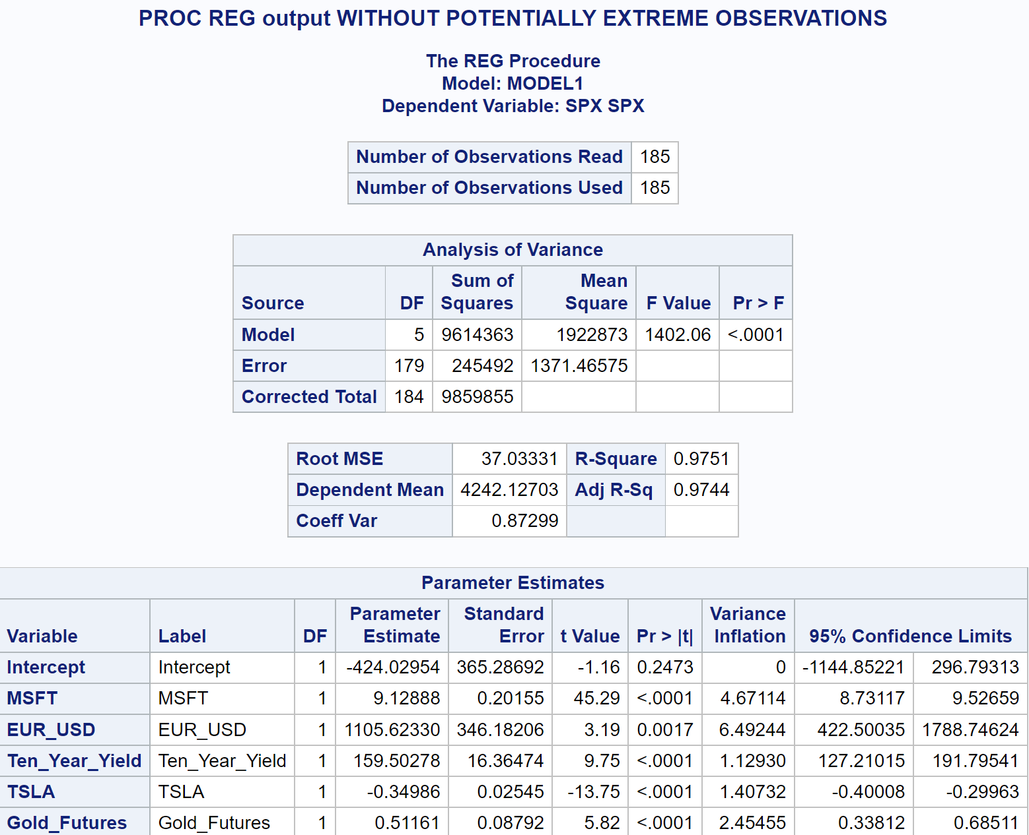
ANOVA without outliers
No Multi-collinearity exists as VIF’s < 10
Adjusted R-Square increased to 0.9744 from 0.9664

Slide 20
Regression Model
Y-Hat = -424.03 + 9.13 * MSFT + 1105.62 * EUR_USD + 159.50 * Ten_Year_Yield – 0.35 * TSLA + 0.51 * Gold_Futures

Slide 21
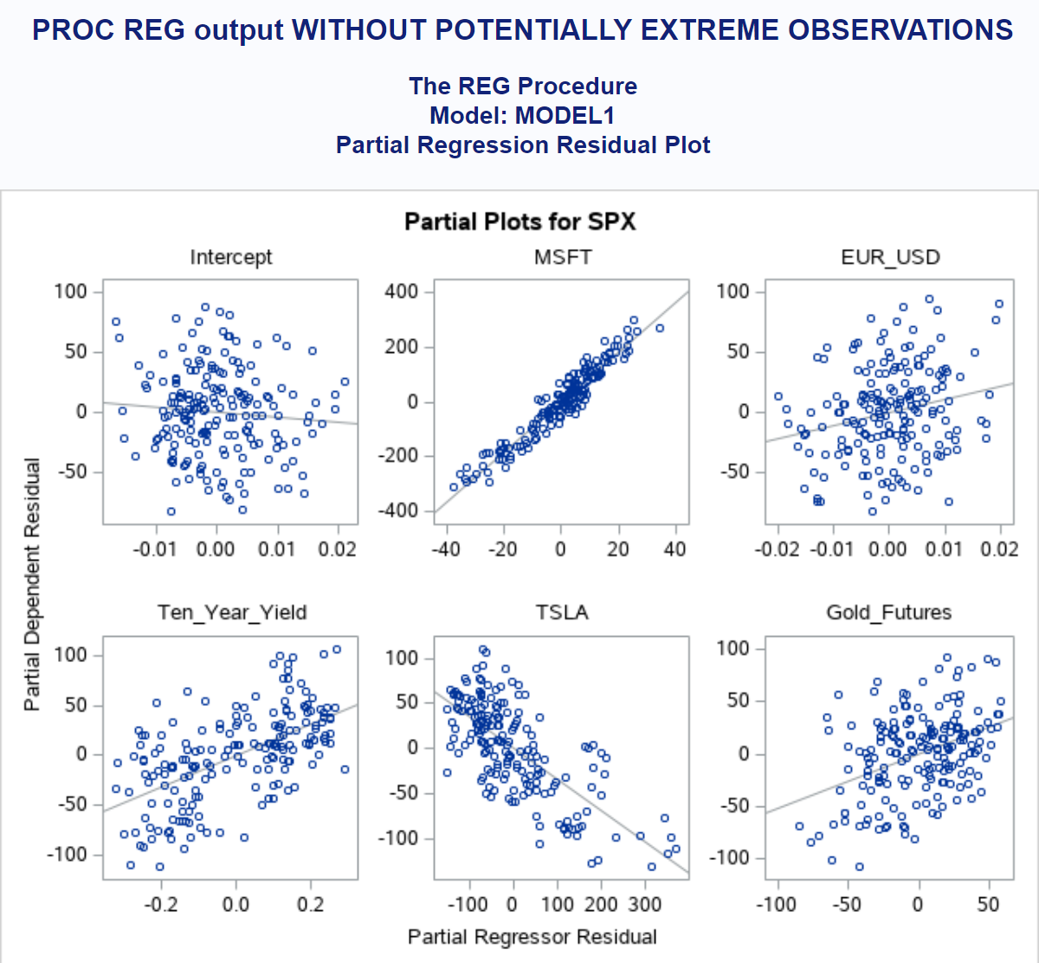
Partial regression plots

Slide 22
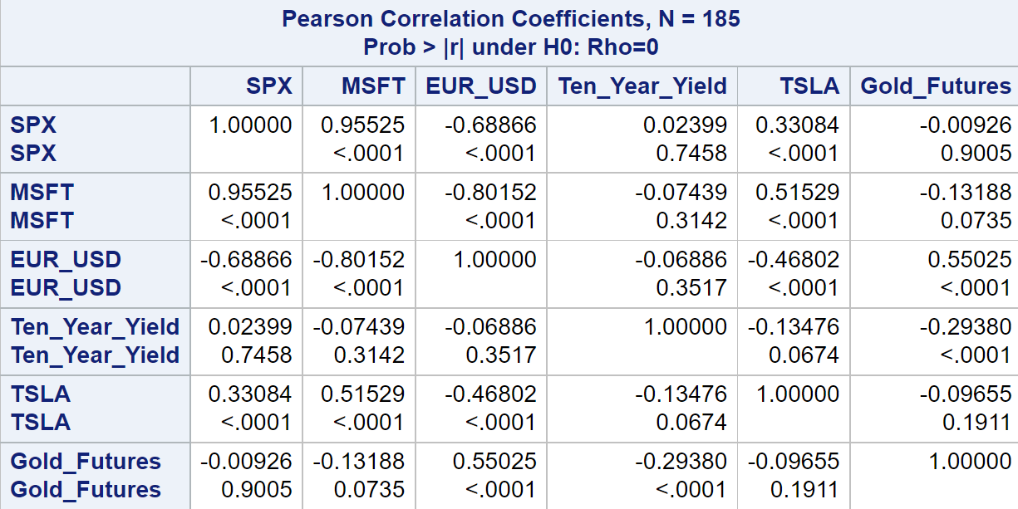
Correlation Matrix

Slide 23
Model Validation
We want to measure the predictive power of our model on a new data set, or on a partition of our original data and compare against a trained data set
We also want to avoid a model that over-fits our data at the cost of under-fitting new data from the same population

Slide 24
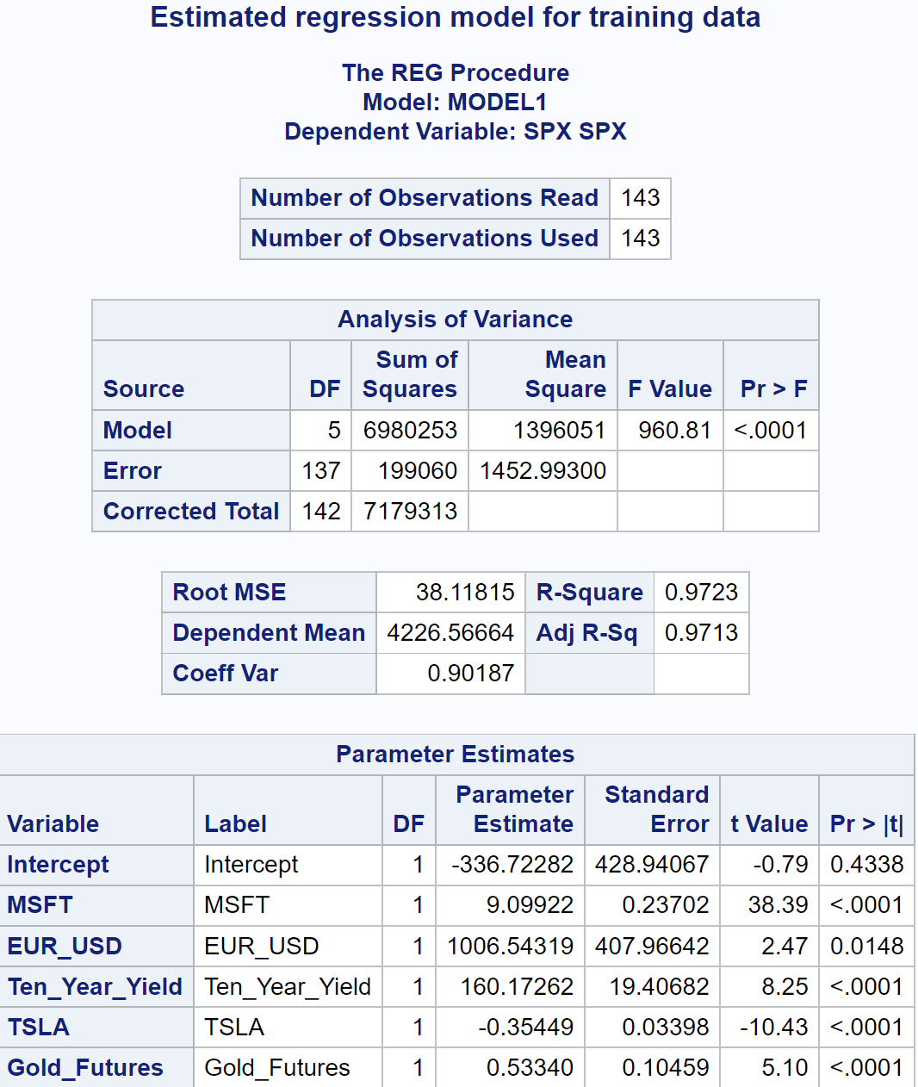
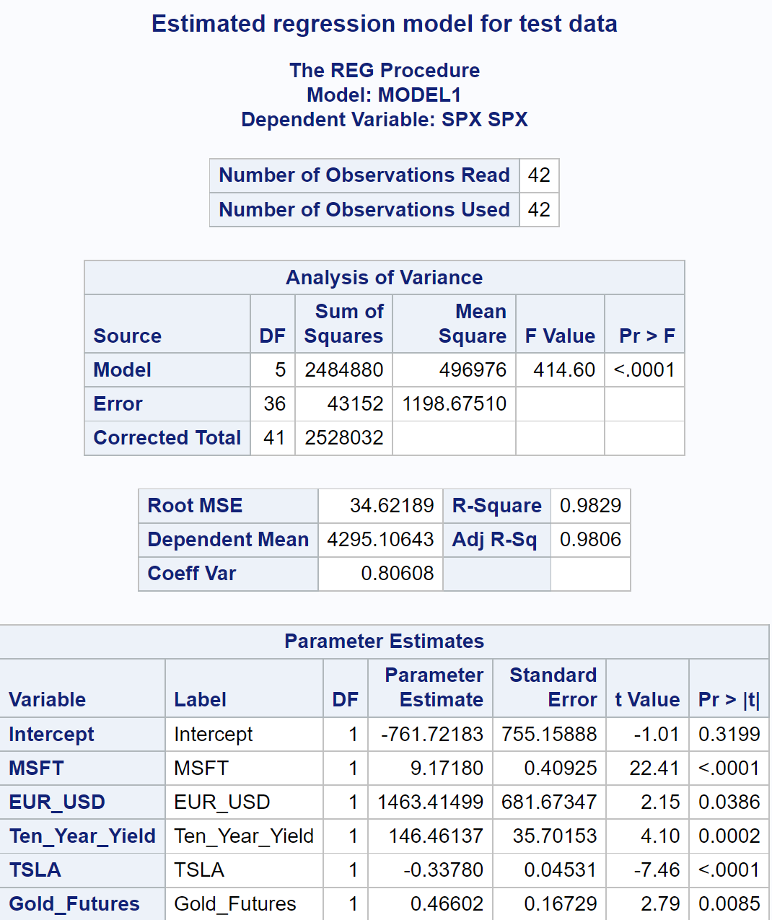



Slide 25
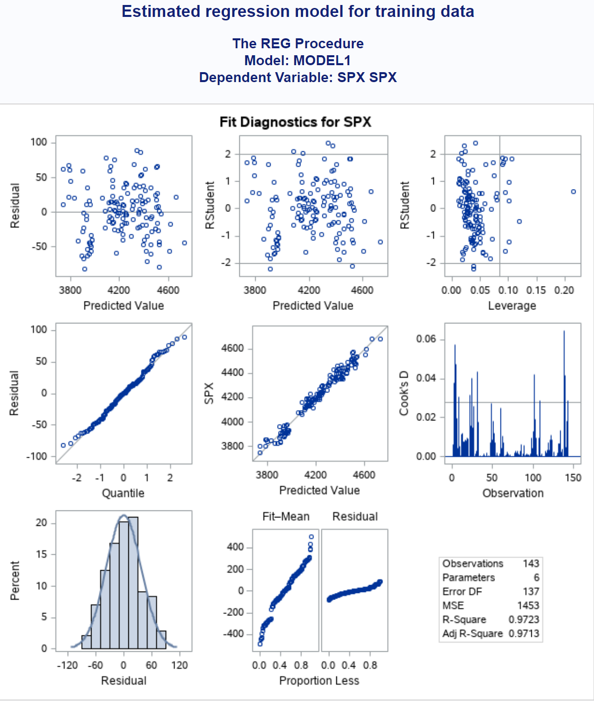
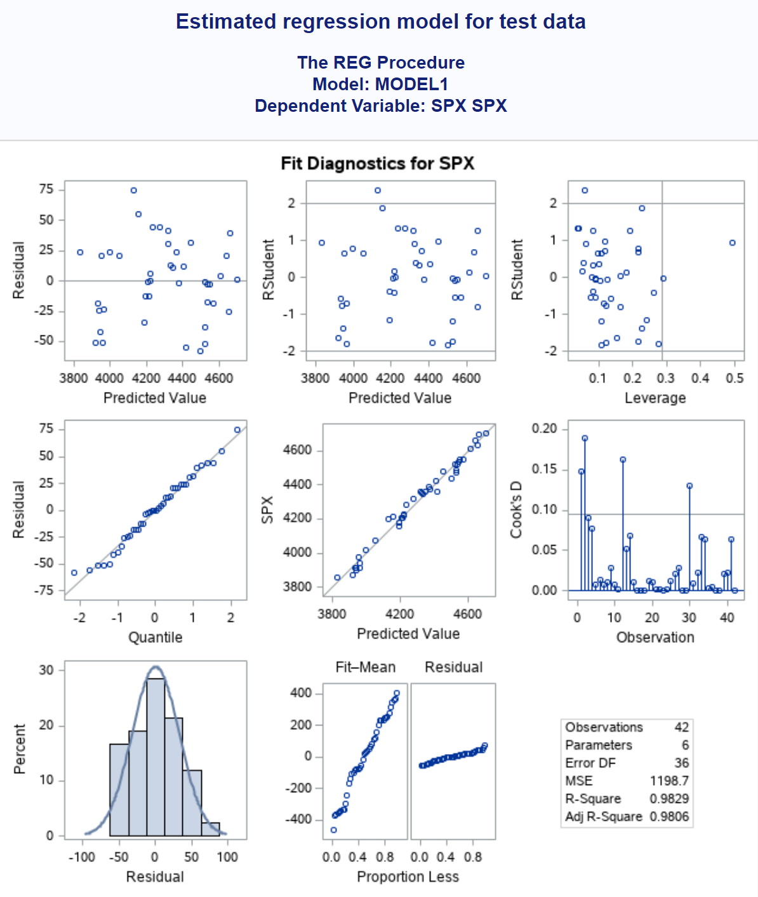

Slide 26
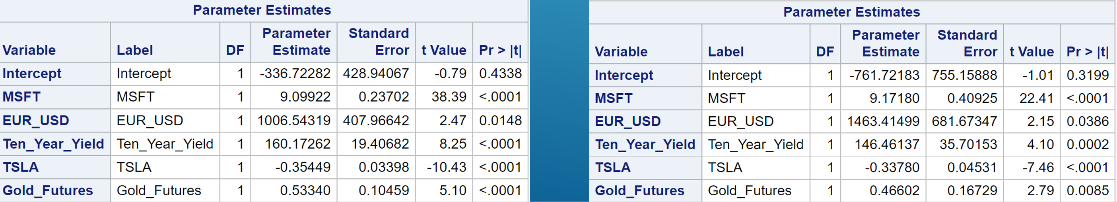
Signs on the parameter estimates are the same for the training and test data sets
Intercept and EUR_USD had the biggest change when we compare the test to the training data
Next time, we can try to delete EUR_USD variable to reduce the standard error (RMSE) in our model

Slide 27
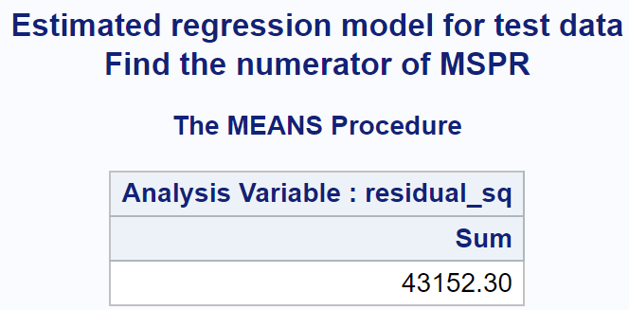
Mean-Squared Prediction ERROR
MSPR = 43,152.30 / 42 = 1027.44
MSE from Training data set was 1452.99
Since MSPR and MSE(Training) are close enough, our model has good predictive power and does not pose the problem of over-fitting

Slide 28

Thank you! Any Questions?

